Slide 1
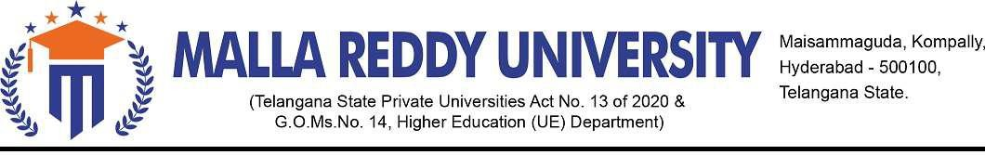
eNOTES Batch Number : CSE GROUP NO -51 By
Name of the student Roll Number
A.Anjali Reddy 2211CS010027
Ch.Thirmal Raju 2211CS010112
M.Charankumar 2211CS010327
B.Sravan kumar 2211CS010071
Under the Esteemed Guidance of
Dr.G.JOSE MOSES

Slide 2
OVERVIEW of the Presentation:-
Title Explanation
Abstract of the Application
Introduction to the Application
Problem Statement
Objectives Existing Methods
Proposed System
Design
Results
Conclusion
Future Scope
References

Slide 3
TITLE EXPLANATION :
The title "eNOTES" stands for an electronic notes system. specifically designed as a Student Management System.
It serves as a comprehensive platform to manage various aspects of student information, including login credentials, examination records, attendance records, discipline records, and the ability to upload, view, and manage PDF documents.
This Java-based application utilizes a graphical user interface (GUI) built with Java Swing and integrates a SQLite database for data storage.

Slide 4
ABSTRACT OF THE APPLICATION :
The "eNOTES" application is designed to manage student information, examination records, attendance records, and discipline records in an educational setting.
The application provides a user-friendly interface for users to log in, access student details, upload and view PDF documents, and maintain various records.
This document outlines the objectives, proposed system, methodology, system architecture, data flow diagrams, system requirements, screenshots, conclusion, and future enhancements for the "eNOTES" application.

Slide 5
INTRODUCTION TO THE APPLICATION :
In educational institutions, managing student information efficiently is crucial.
The eNOTES application addresses this need by providing a user-friendly interface to perform various tasks related to student data.
From basic login authentication to handling complex tasks such as recording examination results and managing discipline records, eNOTES streamlines administrative processes.

Slide 6
PROBLEM STATEMENT :
Traditional methods of maintaining student records and documents involve manual data entry and paper-based systems, which can be time-consuming and prone to errors.
The need for a more organized and digitized system for managing student-related information is evident.
The eNOTES application addresses this issue by offering a digital platform for handling student details, examination records, attendance records, discipline records, and associated PDF documents.

Slide 7
OBJECTIVES :
The main objectives of the "eNOTES" application are:
Provide a secure login mechanism for authorized users.
Enable users to view and manage student details, including examination records, attendance records, and discipline records.
Allow users to upload PDF documents to the system.
Facilitate the viewing of uploaded PDF documents.
Maintain a user-friendly interface for easy navigation and interaction.

Slide 8
EXISTING METHODS :
Traditional methods of maintaining student records involve manual paperwork or the use of spreadsheet software.
Data Accuracy: Manual data entry increases the risk of errors, and ensuring the accuracy of information becomes a constant challenge.
Limited Collaboration: Collaboration between different departments may be hindered due to the physical separation of records and the lack of a centralized system.
Accessibility Issues: Accessing student records outside of the physical location where records are stored can be problematic.
Security and Privacy: Maintaining the security and privacy of student information is challenging in a paper-based system.
Lack of Automation: Processes such as generating reports, analyzing student performance trends, and managing documents lack automation, leading to inefficiencies.

Slide 9
PROPOSED SYSTEM :
The eNOTES application proposes a comprehensive digital solution for managing student-related information.
It introduces a secure login system, a user-friendly interface for data entry, and the capability to handle PDF documents associated with students.
The proposed system aims to improve data accuracy, accessibility, and overall efficiency in managing student records.

Slide 10
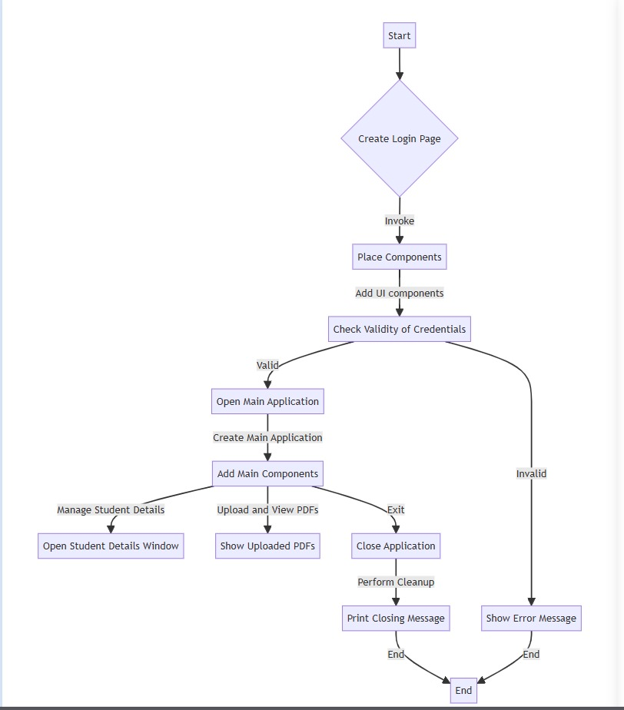
Design:

Slide 11
SYSTEM ARCHITECTURE:
Software Requirements:
Java Development Kit (JDK)
SQLite Database
Java Swing Library
Operating System: Windows (for the provided database URL)
Hardware Requirements:
Processor:
Minimum: Dual-core processor (e.g., Intel Core i3 or equivalent) Recommended: Quad-core processor or higher
RAM (Memory):
Minimum: 4 GB
Recommended: 8 GB or higher

Slide 12
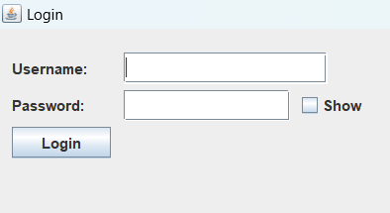
Results:
Fig 01 Login

Slide 13
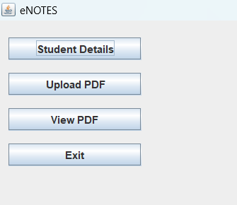
Fig 02 Main page

Slide 14
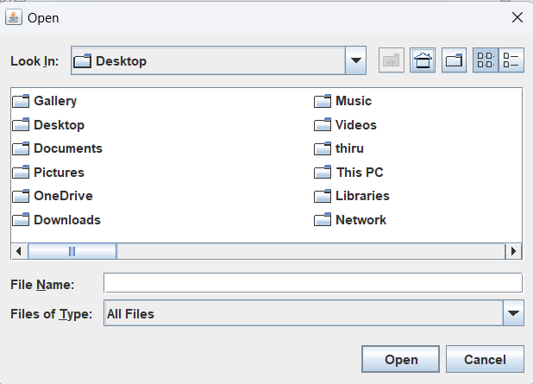
Fig 03 Pdfs from various resources

Slide 15
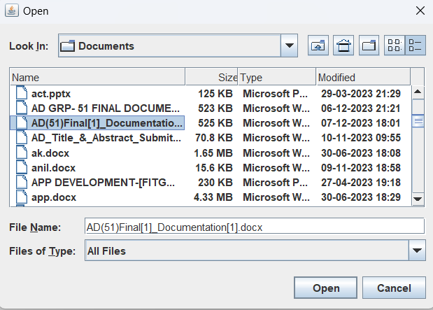
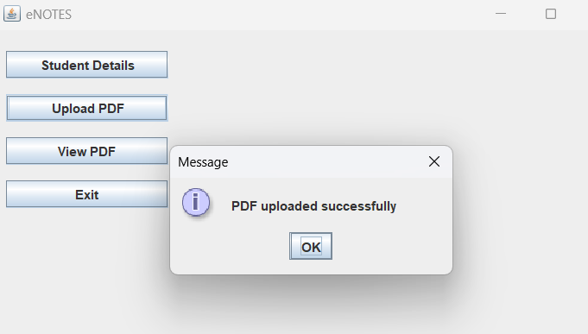
Fig 04 Pdf Uploading

Slide 16
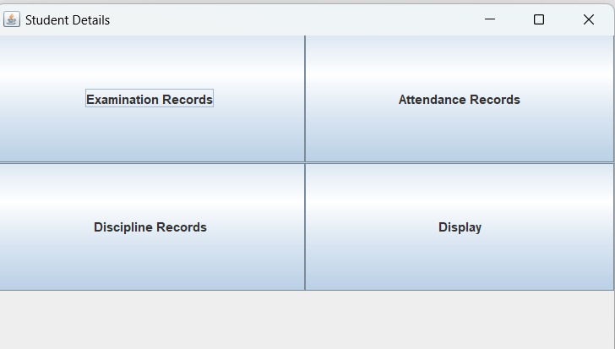
Fig 05 Student details

Slide 17
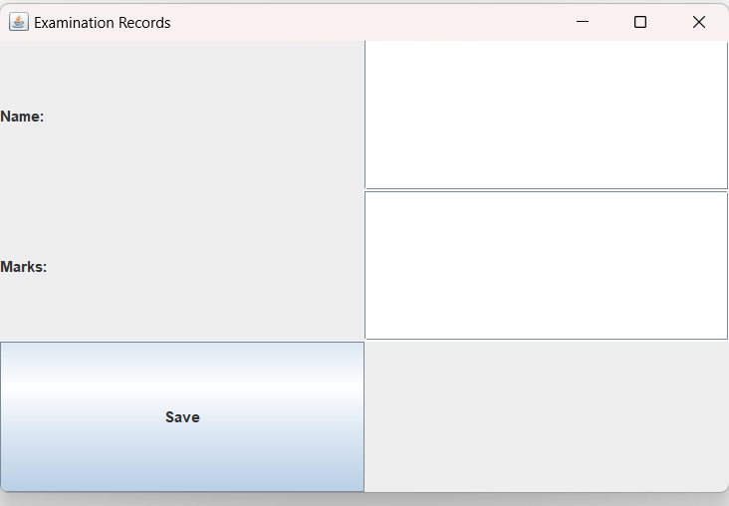
Fig 06 Examination Records

Slide 18
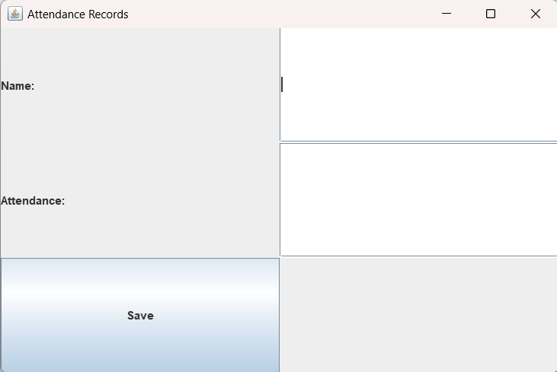
Fig 07 Attendance Records

Slide 19
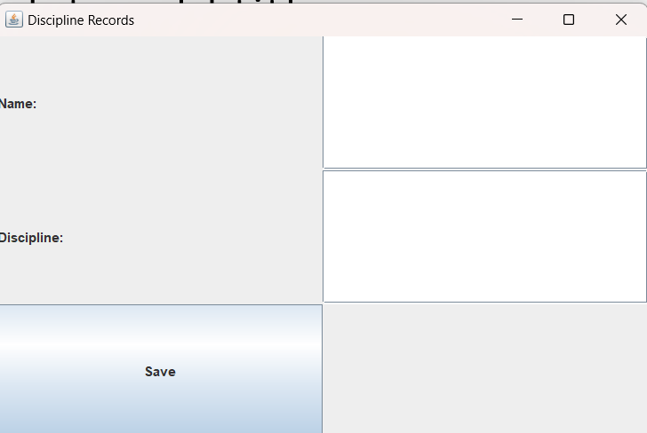
Fig 08 Discipline Records

Slide 20
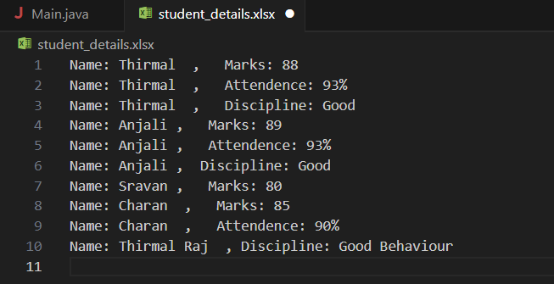
Fig 09 Storing Student details

Slide 21
FUTURE SCOPE :
Automated Notifications:
Implement automated notification systems for important events, such as exam results, upcoming deadlines, or disciplinary issues.
Allow customization of notification preferences for users.
Mobile Application:
Develop a mobile version of the eNOTES application for on-the-go access to student records.
Ensure a responsive design for various screen sizes and devices.
Enhanced Security Measures:
Strengthen security features, including role-based access controls and encryption, to safeguard sensitive student information.
Implement two-factor authentication for added security.
Parent and Student Portals:
Create dedicated portals for parents and students, allowing them to access relevant information such as grades, attendance, and announcements.
Foster better communication between educators, parents, and students.
Gamification for Attendance and Discipline:
Introduce gamification elements to encourage positive student behavior, attendance, and discipline.
Use reward systems and achievements to motivate students.

Slide 22
REFERENCES
1. https://fliphtml5.com/learning-center/free-pdf-sharing-sites-platforms/
2. https://www.blackboard.com/group/136
3. https://schoology.wintondrivedistrict.org/login?&school=233114456
4. https://github.com/Lubomir1998/Student_Management_System
5. https://github.com/Sabestin/Attendance-Management-System

